Slide 1
Convolutional Correlation Filter for 2d Multi-scale Visual Tracking
Zheng Li
Sun Yat-sen University
Advisor: Dr. Changdong Wang
Notes:
老师们下午好，我叫李正，我的毕业选题为基于在线卷积网络的相关滤波二维多尺度跟踪

Slide 2
Outline
Motivation
Correlation filter
Cross-Correlation
Tracking framework
Minimum output of sum square error(MOSSE)
Multi features based Correlation filter for visual tracking
Correlation filter for scale estimated
Lightweight Convolution network
Convolution Auto-Encoder(CAE)
3D convolution image representation
Experiment results
Notes:
Out presentation mainly consists of 5 sections. The motivation, feature extraction, tracking framework, online learning and experiments results

Slide 3
Tracking Problem
Tracking problems are divided into two parts:
Position prediction
Scale estimation
Notes:
The figure shows our algorithm procedure briefly. Generative and discriminative trackers are two main types of appearance-based trackers. Our method belongs to the latter, that is to say tracking be detection. At the t frame, we will obtain positive and negative samples around tracking object and extract our compressive perceptual hashing features. In the next frame, we will generate a series of candidates by coarse-to-fine search strategy. And then we will conduct confidence evaluation, and regard the candidate location of maximum confidence response as new position of object

Slide 4
Experiment Demo

Slide 5
Motivation
We present a convolutional network with a lightweight structure for visual tracking without offline training.
We are the first to transfer robust convolution features for correlation filter.
In account of unequal variation of object scale, We present 2d space correlation filter for scale estimation
Notes:
It’s quite common these days that visual tracking has become one of the most key components for numerous robot applications, such as robot human interaction, robot navigation and autonomous driving. Here, we introduce a simple and fast novel hashing methods for visual tracking. We adopt the combination of perceptual feature + LSH and compressive sensing methods as the discrimination object representation. Most importantly, the purpose of using hashing is no need to train classifier, which contributes to faster speed. Besides, we use a novel online foreground learning methods in order to solve model draft problem

Slide 6
Cross-correlation
The concept of signal processing field
Measure similarities between two signals at time

Slide 7
Correlation filter
Tracking task：find the filter template
FFT

Slide 8
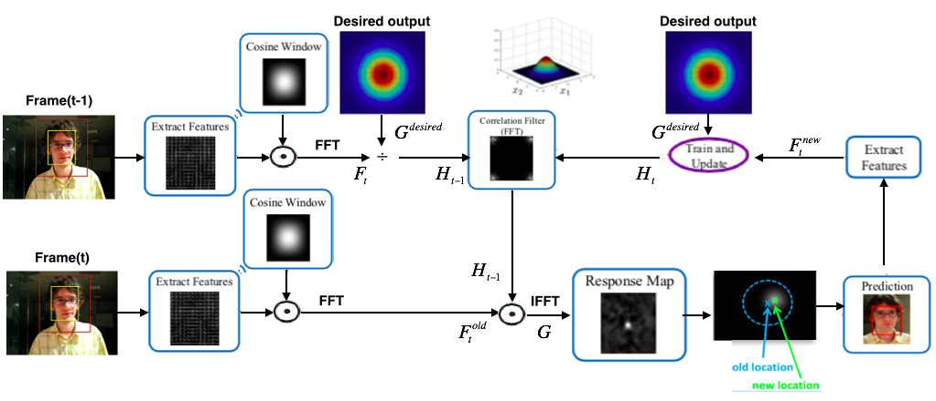
Correlation filter for visual tracking
Tracking framework

Slide 9
Minimum output of sum square error(MOSSE)
Cost function:
Take m images of object into consideration to make filter
template more robust.
Solution:
Filter update:
Correlation response：

Slide 10
Multi features based Correlation filter for visual tracking
Cost function:
Solution:
Filter update:
Correlation response：

Slide 11
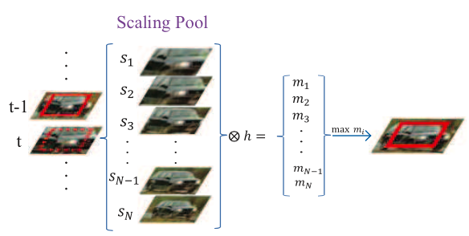
Correlation filter for scale estimated
Scale samples
The reason for exponent changes: coarse search big scale, fine search small scale

Slide 12
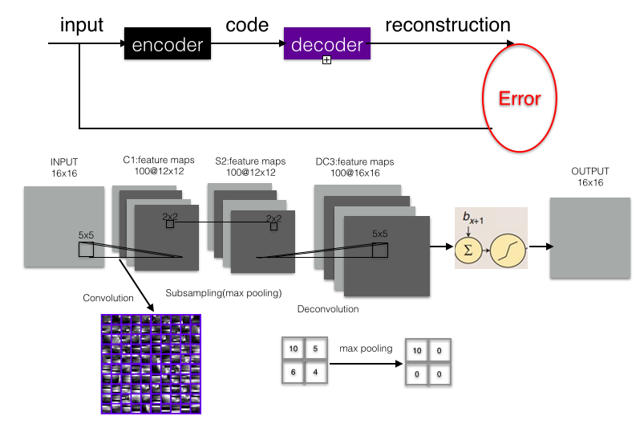
Convolution Auto-Encoder(CAE)

Slide 13
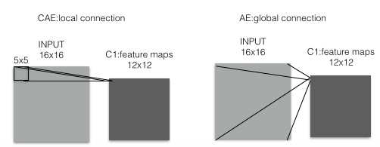
Convolution Auto-Encoder(CAE)
Advantages:
Different from hand-drafted traditional features, using unsupervised learning for data-drafted features
Due to convolution operation(local receptive field), CAE can
capture image structure and local correlation better than common AE(DAE, SAE).

Slide 14
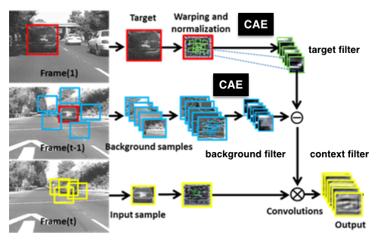
3D Convolution image representation

Slide 15
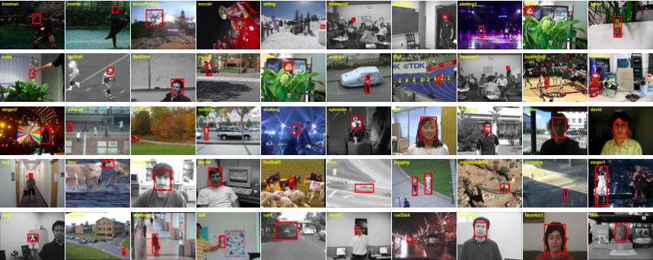
Experiment Results
matlab & c++ mixed programming
15 state-of-the-art compared trackers and TOB-50 dataset from visual tracking benchmark.
Robust to 11 different attributes challenges
Illumination Variation(IV)
Scale Variation(SV)
Occlusion(OCC)
Deformation(DEF)
Motion Blur(MB)
Fast Motion(FM)
In-Plane Rotation(IPR)
Out-of-Plane Rotation(OPR)
Out-of-View(OV)
Background clutters(BC) TOB-50 dataset
Low Resolution(LR)

Slide 16
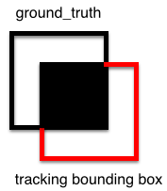
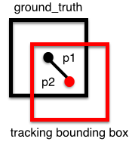
Evaluation metric
Center Location Error(CLE): ||p1-p2||₂
Overlap Score(VOR):
Success Frame: CLE < or VOR >
Distance Precision(DP):
Overlap Success Rate(OS):

Slide 17
Quantitative Evaluation
Overall performance

Slide 18
Attribute-base Evaluation

Slide 19
Attribute-base Evaluation

Slide 20
Attribute-base Evaluation

Slide 21
Attribute-base Evaluation

Slide 22
Attribute-base Evaluation

Slide 23
Attribute-base Evaluation

Slide 24
Research results
Publication:
1. "Compressive Perceptual Hashing Tracking with Online foreground learning", IEEE International Conference on Robotics and Biomimetics (ROBIO, oral)), Zhuhai, CHINA, Dec 2015.
2. "Robust Vehicle Tracking Using Perceptual Hashing Algorithm" IEEE international Conference on Machine Learning and Application (ICMLA, oral), Miami, Florida, USA, Dec 2015.
Submitted:
1.“Accurate Deformation Estimation Using Convolutional Correlation Filter for Visual Tracking” IEEE international Conference on Neural Information Processing Systems, NIPS 2016
2 Checking patents

Slide 25
Thanks for your Listening

